Slide 1
BlackJack using Reinforcement Learning
Vikas Rajpoot
S2021101006
Guided By :
Dr. Arun P V

Slide 2
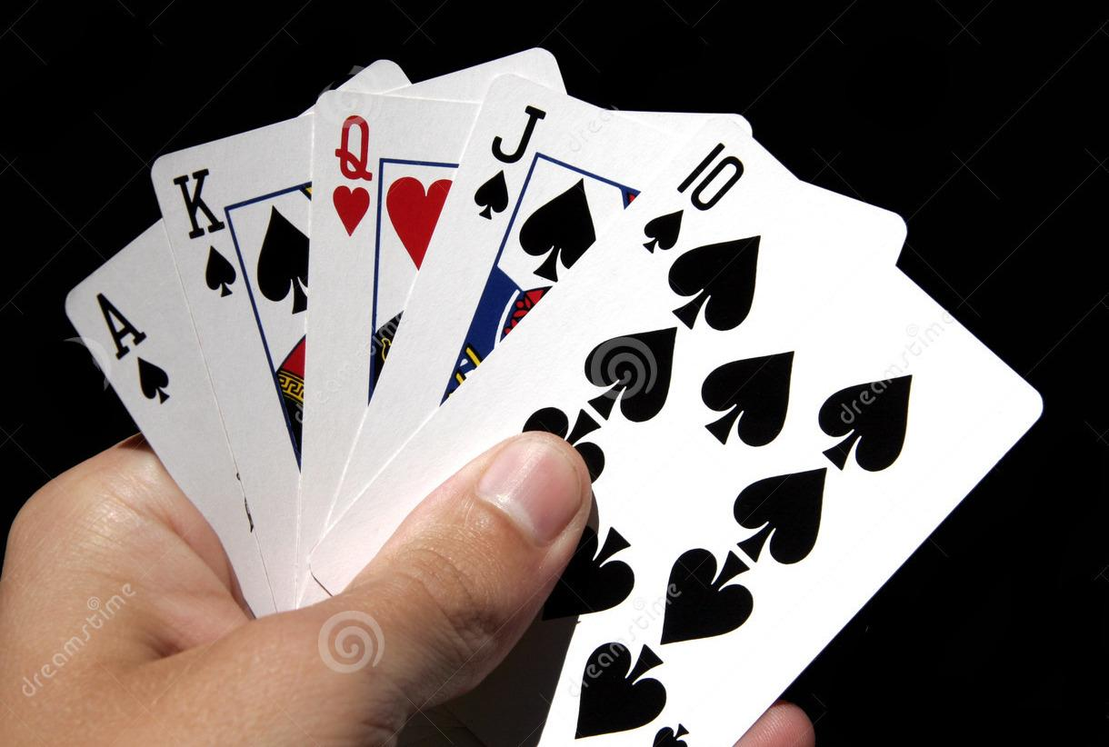
BlackJack Game
Admin
Environment
Environment
Environment
BlackJack is the popular casino Game in which player is playing against the Dealer.
BlackJack :
Ace + (Face card
or 10).
Richard S. Sutton and Andrew G. Barto Ⓒ 2014, 2015

Slide 3
BlackJack Game
Admin
Environment
Rules
Rules
In this game ‘Number card’ weightage is equal to the their value, Face is value is 10 and Ace can be either 11 or 1.
Player win if his score is greater than the dealer score and less then the 21. score is equal to the sum of cards in the hand.
Player’s Actions : Hit or Stick
Hit : Take random card from deck.
Stick : Further player not receive any card and game is over for the player.
Dealer keeps Hit until his score is greater than 17. If score is greater than 17 He stick and both player and dealer show their card.
Richard S. Sutton and Andrew G. Barto Ⓒ 2014, 2015

Slide 4
BlackJack Game
Admin
Environment
Environment Implementation
Environment Implementation
class BlackJack:
def __init__(self) -> None:
def start(self):
def play(self, action):
def __delta_card(self):
def __bust(self, cards, hands):
def __score(self, cards, hands):
def __usable_ace(self, cards, hands):

Slide 5
BlackJack Game
Admin
Environment
Returns
Environment Returns
play function
return {'pCards', 'nState', 'dealers_cards', 'dealers_score', 'action', 'reward', 'done'}
nState : Next state of the agent.
reward : (-1, 0, 1).
done : False / True, if game over for player then True otherwise False.
pCard : cards player have in hand.
dealers_cards : cards dealer have.
dealers_score : score of the dealer i.e. sum of cards.

Slide 6
BlackJack Game
Admin
Agent
Agent
Agent
Agent in this game is the player which try to maximize the average reward over the episodes.
I use Monte Carlo method to implement the Agent.
Agent can take two action Hit or Stick. Accordingly It gets the reward, next state and other parameter from the Environment.
Richard S. Sutton and Andrew G. Barto Ⓒ 2014, 2015

Slide 7
BlackJack Game
Admin
Agent
Monte Carlo
Implementation of the Agent
For Agent implementation there are mainly two part :
Policy evaluation and Policy improvement.
Policy evaluation : I use Monte Carlo Q value evaluation.
Policy improvement : Use Ɛ-Greddy policy improvement.

Slide 8
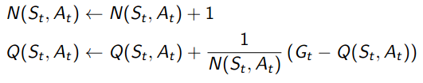
BlackJack Game
Admin
Agent
Monte Carlo
Monte Carlo Model Free Policy Evaluation
State-Action (Sₜ, Aₜ) Value evaluation for each episode.
Richard S. Sutton and Andrew G. Barto Ⓒ 2014, 2015

Slide 9
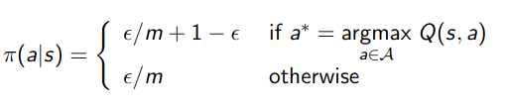
BlackJack Game
Admin
Agent
Monte Carlo
ε-Greedy policy Improvement
ε-Greedy policy allow some exploration.
Richard S. Sutton and Andrew G. Barto Ⓒ 2014, 2015

Slide 10
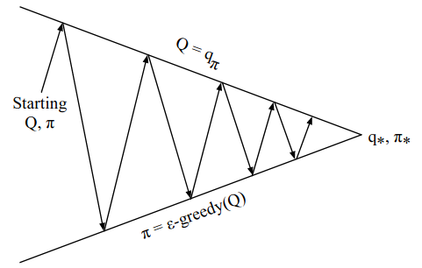
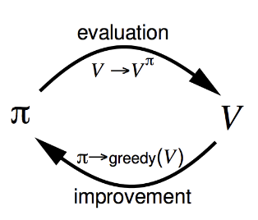
BlackJack Game
Admin
Agent
Monte Carlo
Diagrams
fig. Q values convergence
Richard S. Sutton and Andrew G. Barto Ⓒ 2014, 2015

Slide 11
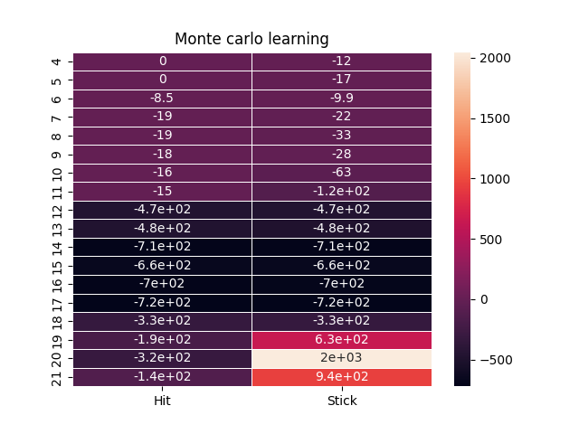
BlackJack Game
Admin
Agent
Monte Carlo
Q value convergence (Results)
fig. Program Q values convergence
Richard S. Sutton and Andrew G. Barto Ⓒ 2014, 2015

Slide 12
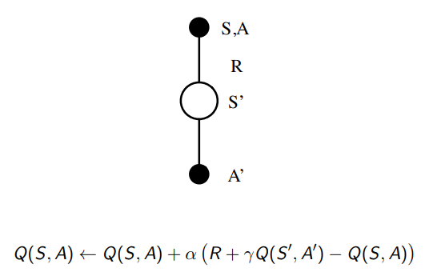
BlackJack Game
Admin
Agent
SARSA
Temporal Difference Learning
The TD method has the characteristics of low variance, online learning, and can learn incomplete sequences, so TD can be used instead of MC for more effective learning.
In TD learning, Q is also used as an estimated value, and
𝜖−𝑔𝑟𝑒𝑒𝑑𝑦 is used as The strategy is optimized, and the Q value is updated at each time step.
Richard S. Sutton and Andrew G. Barto Ⓒ 2014, 2015

Slide 13
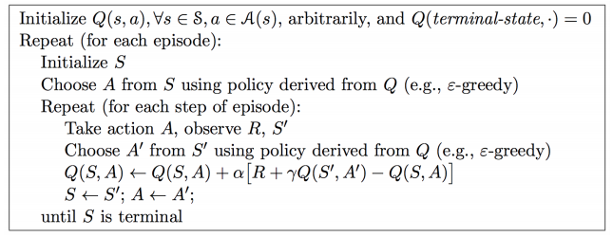
BlackJack Game
Admin
Agent
SARSA
Algorithm for TD(1)
Richard S. Sutton and Andrew G. Barto Ⓒ 2014, 2015

Slide 14
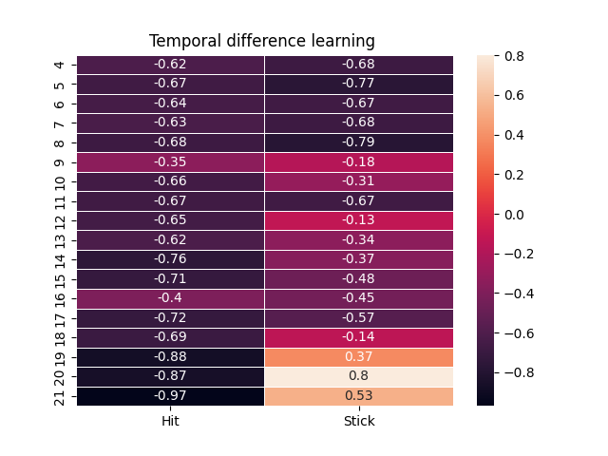
BlackJack Game
Admin
Agent
SARSA
SARSA Results
Richard S. Sutton and Andrew G. Barto Ⓒ 2014, 2015

Slide 15
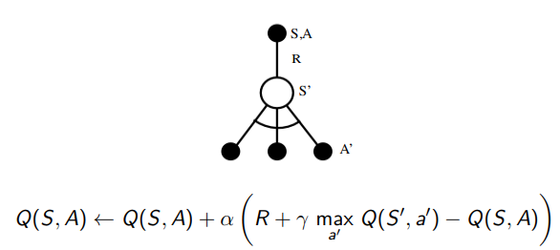
BlackJack Game
Admin
Agent
Off policy Q Learning
Off Policy Q-Learning
Off-policy refers to interacting with the environment through the 𝜇 strategy (performance strategy), obtaining the sequence of S, A, R as experience, and using the experience to evaluate and optimize the learning method of another strategy 𝜋.
Richard S. Sutton and Andrew G. Barto Ⓒ 2014, 2015

Slide 16
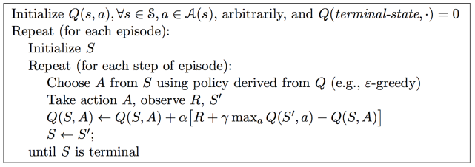
BlackJack Game
Admin
Agent
Off Policy Q Learning
Algorithm
Richard S. Sutton and Andrew G. Barto Ⓒ 2014, 2015

Slide 17
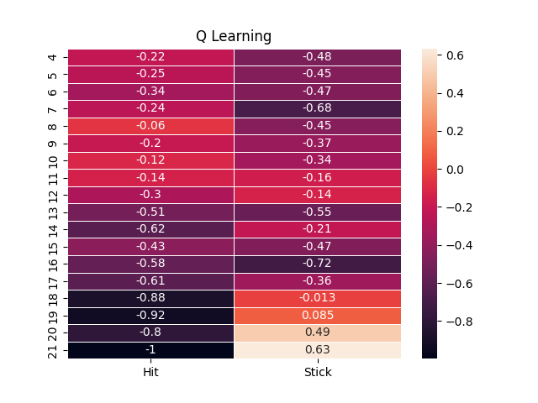
BlackJack Game
Admin
Agent
Off Policy Q Learning
Off Policy Q-Learning Results
Richard S. Sutton and Andrew G. Barto Ⓒ 2014, 2015

Slide 18
Thank You

